Slide 1
Managing Different Image Sizes
David Gormley

Slide 2
Should we use a different image format? (perplexity)
Current Approach: 8 bit PNG (perplexity)
Pro
Same # pixels (as 16/32 bit TIFF)
Faster
16 bit -> ~1.5–2× slower(perplexity)
32 bit -> ~3–4× slower(perplexity)
Con
Less fine grained color detail
8 bit = 256 color values/channel
65,536 color values/channel in 16 bit (https://www.primoprint.com/blog/the-difference-between-8-bit-and-16-bit-images-and-how-to-utilize-each/, https://skylum.com/blog/8-bit-vs-16-bit-photos-whats-the-difference, Difference between 8-bit and 16 bit Color Format in DIP)
Alternative: Uncompressed TIFF
Pro:
16,32 bit channels -> “preserves… subtle pixel-level detail” (perplexity)
more color models (CMYK, RGB, etc)
Typical histopathology file format bc no compression (https://ijrpr.com/uploads/V3ISSUE11/IJRPR7800.pdf)
Supported by “all major deep learning and pathology imaging libraries” (https://ijrpr.com/uploads/V3ISSUE11/IJRPR7800.pdf) (https://www.nature.com/articles/s43856-022-00186-5)
Con:
Slower runtime
Must ensure architecture supports # of bits
Special data loaders required to manage 16+ bit etc.

Slide 3
Some photos are too small to be useful. What should our filtering threshold be?
Code for this section: https://colab.research.google.com/drive/18rDTFv8Xu9zAdD3RHYgHVW4a2ygWFWNC?usp=sharing

Slide 4
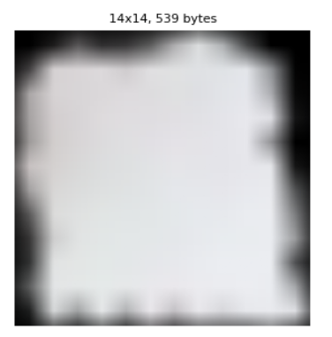
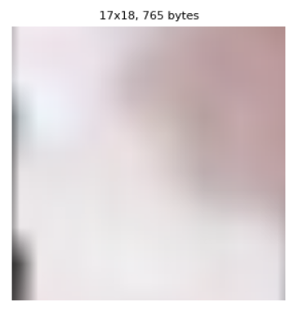
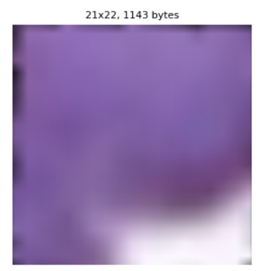
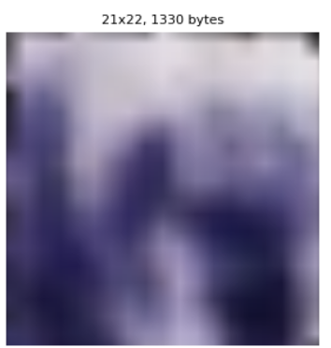
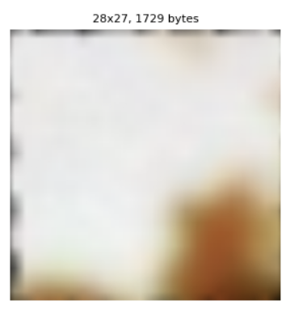
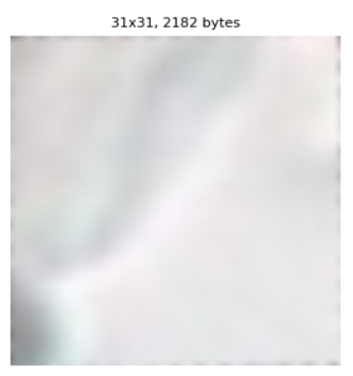
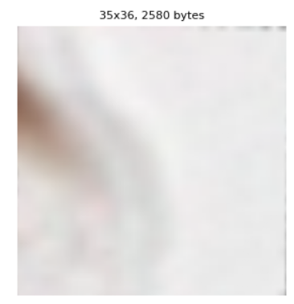
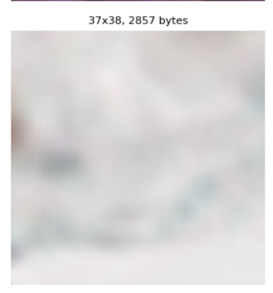
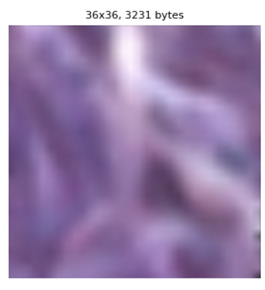
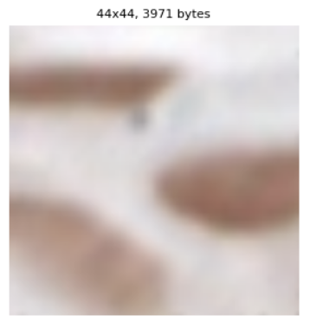
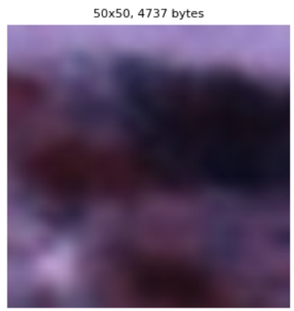
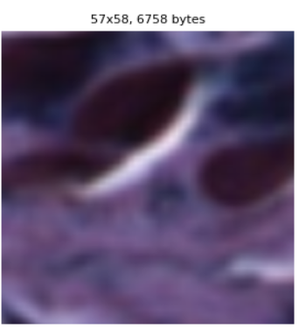
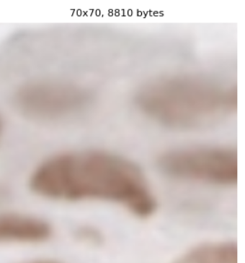
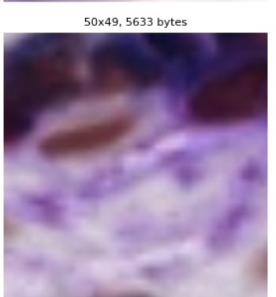
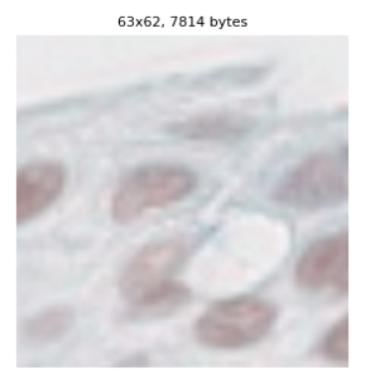
Visual threshold analysis (Current threshold is 2KB)
These photos removed based on threshold of 2KB

Slide 5
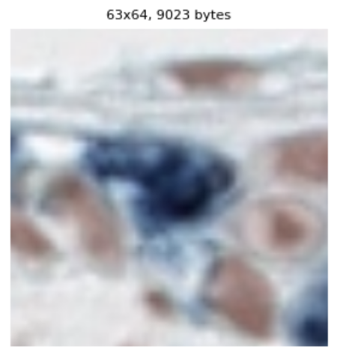
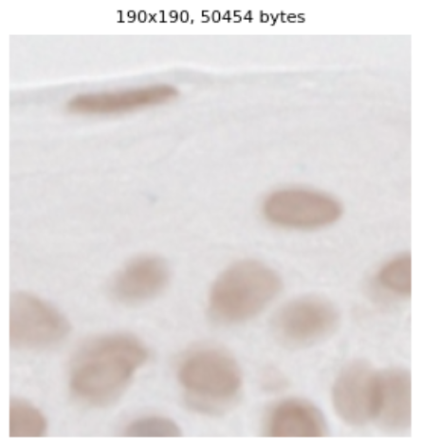
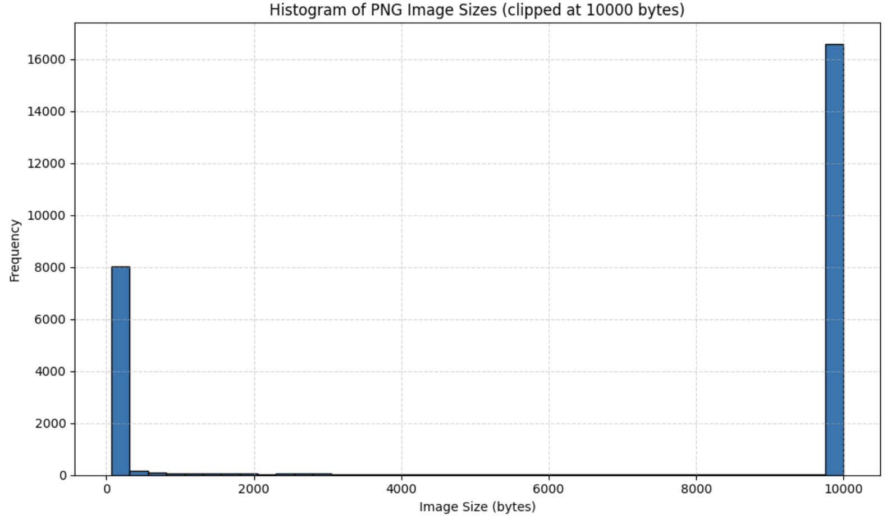
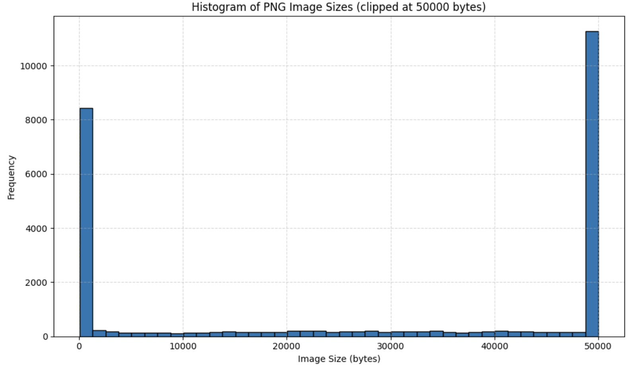
Distribution Analysis with old patches: Is 2KB a good threshold?
0.5KB
10KB
50KB
Even if 10KB too small, 63.6% of photos > 2KB are greater than 50KB
almost all photos > 2KB are greater than 10KB
< 0.5KB useless
Is 10KB good enough?
50KB looks strong
2KB

Slide 6
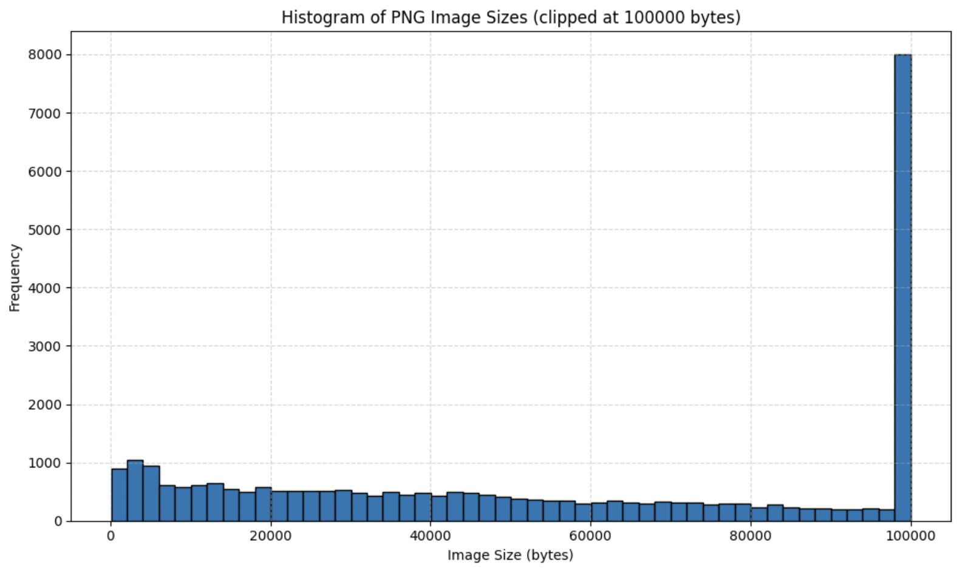
Distribution Analysis with new patches: Is 2KB a good threshold?
Now only 2.96% photos are < 2KB
No clear division point
Trade-off between data quality and quantity
2KB

Slide 7
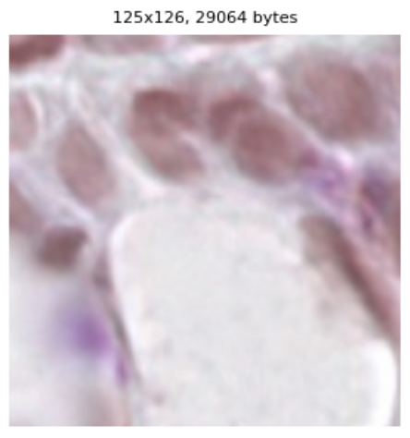
30KB: A far more restrictive threshold?
One study found improvements by only using images > 128x128 pixels
Both this study and our CMIL study use 40x zoom (https://lup.lub.lu.se/student-papers/search/publication/8956950)
How much data would we lose?
32.89% of new patches are < 30KB
Weighing image quality and quantity
What is the smallest image size that we need to classify?
125x126 pixels
≅30KB

Slide 8
Q4: How should we deal with different image sizes?
What is the downside of adaptive pooling?
What if we use patches of 3-4 distinct sizes?

Slide 9
Managing Different Image Sizes: 4 Approaches

Slide 10
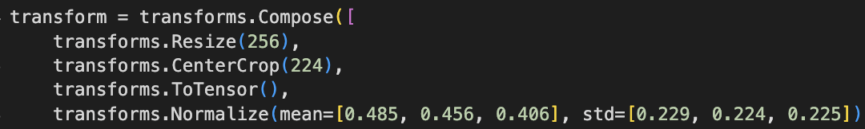
Approach #1: Resizing images before CNN
Current approach in Sharon’s code
What does this code do? (help from ChatGPT)
Resizes all images to 256x256 (assumes square images)
Crops a 224x224 square from center of 256x256 image
We should not do this bc lost information!
Turns the image to PyTorch tensor and scales/normalizes

Slide 11
Issues w/ Approach #1: Resize images before CNN (perplexity)
Key issue: We are distorting data before it even enters CNN
Issues for small images (<256x256)
New artifacts created: “grid-like patterns that mimic pathological features.” (perplexity citing https://pmc.ncbi.nlm.nih.gov/articles/PMC5967747/)
Blurs edges of cells -> “reducing the accuracy of pagetoid spread detection by 23% in high-grade CMIL cases” (perpleixty citing https://boris.unibe.ch/160453/1/Lobachev_Evaluating_registrations_of_serial_sections_with_distortions_of_the_ground_truths.pdf)
Issues for big images (>256x256)
Bilinear interpolation (mean of nearby pixels weighted by distance) can wrongly smooth out information/patterns
“Reduces interobserver agreement (κ) from 0.85 to 0.72 in validation studies:” (Perplexity citing https://meridian.allenpress.com/aplm/article/133/1/57/460622/Impact-of-Digital-Image-Manipulation-in-Cytology)
Bottom line: We should not simply resize images before using CNN

Slide 12
Approach #2: adaptive pooling (Help from ChatGPT)
What is adaptive pooling?
Key Idea: Stride and kernel hyper params in convolutional layer change the output size of that layer
Fixed Image Size -> Normal CNN
Normal CNN has fixed stride and kernel hyper params -> Fine if all images same size bc all outputs from that layer same size
Varied Image Sizes -> Adaptive Pooling Layer
Adaptive pooling layer chooses the stride and kernel hyper params based on image input size so that output of that layer is consistent size
Notes:
Adaptive pooling layer generally used right before fully connected layers

Slide 13
Should we use adaptive pooling? (from perplexity)
Cons (Q4: What is the downside of adaptive pooling?l)
Inconsistent information compression (perplexity)
Cells in big images compressed more than cells in small images
Cells are treated differently depending on the image size
Aggressive compression
Normal CNN: compression by fixed amount each layer
Adaptive Pooling: Large images may be aggressively compressed in one layer
More compute than approach #1 (perplexity)
Pros
Models w/ adaptive pooling can process images of any size
compression late in CNN network
Lower compute than U-Net “Reduces VRAM usage by 63% compared to fixed-size processing” (perpleixty)
We can process different sized images in same batch (perplexity)
Notes:
Loss of information
For small patches -> Can misclassify low-grade CMIL
Can conceal “cell boundaries” -> Hard to see cell “cell shape, size, and arrangement” and number of cells
Nuclear detail lost -> “Inability to distinguish subtle nuclear atypia, which is critical for differentiating benign from low-grade CMIL.”
For big patches
small patches (“Obscures nuclear atypia in 38% of low-grade CMIL cases”)
Cannot learn “scale-specific features” defined in WHO-EYE05 criteria

Slide 14
Approach #3: FCN U-Net (perplexity)
Cons
Harder to train
Lots of hyper params
Data augmentation
4-6x slower training relative to adaptive pooling (https://pmc.ncbi.nlm.nih.gov/articles/PMC9777521/) (https://github.com/prasannaghimiree/Breast-Cancer-Histopathology-Image-Segmentation-using-U-Net)
Pros
Maintain spatial relationships
Consistent cell-level information compression
e.g. 10x10 pixel cell is compressed same for any image size
Can extract features “at scales proportional to the original tissue sample” (perplexity)

Slide 15
Approach #4: Resize images to 3 standard sizes then HookNet
Q4: Should use patches of 3-4 distinct sizes?
Resize images to 3 standard sizes
Use HookNet to process images of 3 sizes
HookNet uses a different encoder-decoder for each size with “hooking” overlap between layers in the encoder-decoders (ChatGPT)
Pros
High performance: Better than U-Net? (https://arxiv.org/abs/2006.12230#:~:text=single%2Dresolution%20U%2DNet%20models)(https://pubmed.ncbi.nlm.nih.gov/33260110/#:~:text=single%2Dresolution%20U%2DNet%20models)
Less aggressive distortion than resize to single dimension (256x256)
Cons
Very high compute (2x U-Net) bc multiple encoder-decoders (ChatGPT)
Image distortion through resizing

